Slide 1

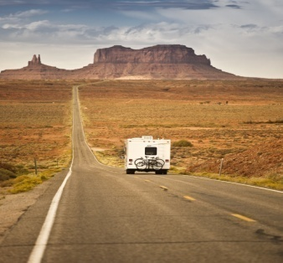
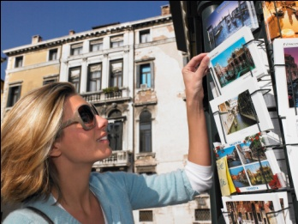

3
Unit 4 Section A
The Surprising purpose of travel
Notes:
1

Slide 2

Functional Patterns | Functions & Usages
1. Sb. almost do…before…and sb. do…, remembering that… | 用于表达“某人受到暗示或提示后采取的行动”。
2. Sb. do sth. because sb. like / dislike to, because…. | 用于表达“某人喜欢/不喜欢做某事的种种原因”。
3. According to research, sth./sb. do…, making /leading … | 用于引证，表达“研究发现/结果表明”。
Notes:
2

Slide 3

Practical Phrases | Specific Meanings
1. be offset by sth. | 由……抵消
2. on sale | 廉价出售
3. be saturated with | 充满；使饱享
4. mingle… with … | 与……混在一起
5. endow …with… | 赋予……(天资)
6. be open to sth. | 愿意考虑……
7. more often than not | 往往， 多半

Slide 4

由……抵消
短语逆译
be offset by sth.
短语应用
他们增加的工资会被上涨的物价所抵消。
意群提示
(salary increase /rising prices )
Their salary increase will be offset by rising prices.

Slide 5
廉价出售
on sale
短语逆译
短语应用
通过阅读这份广告，你也许会发现想要的某件商品正在减价。
意群提示
(advertisement / on sale)
By reading the advertisement, you may find something you want on sale.

Slide 6
充满；使饱享
短语逆译
be saturated with
短语应用
他们从媒体得到了大量煽情诱人的消息。
意群提示
(powerful and seductive messages/the media)
They've become thoroughly saturated with powerful and seductive messages from the media.

Slide 7
与……混在一起
短语逆译
to mingle… with…
短语应用
校长发表了一个褒贬兼蓄的演讲。
意群提示
( to deliver a speech/praise/blame)
The president delivered a speech that contained praise mingled with blame.

Slide 8
赋予… (天资)
短语逆译
to endow … with …
短语应用
将军忠实的拥护者们几乎把他当神一样看待。
意群提示
( devoted supporter /godlike status)
The general’s devoted supporters endow him with an almost godlike status.

Slide 9
愿意考虑…
短语逆译
be open to sth.
短语应用
我肯定他们会愿意倾听大家任何意见和建议。
意群提示
(be sure/ any comments and suggestions from…)
I’m sure they will be open to any comments and suggestions from everyone.

Slide 10
往往， 多半
短语逆译
more often than not
短语应用
人们觉得不幸福多半是因为他们太容易受到外界的影响了。
意群提示
( be easily affected/ the outside world)
More often than not, people are not happy because they are too easily affected by the outside world.

Slide 11
Functional Patterns | Functions & Usages
1. Sb. almost do…before…and sb. do…, remembering that… | 用于表达“某人受到暗示或提示后采取的行动”。
2. Sb. do sth. because sb. like / dislike to, because…. | 用于表达“某人喜欢/不喜欢做某事的种种原因”。
3. According to research, sth./sb. do…, making /leading … | 用于引证，表达“研究发现/结果表明”。
Notes:
11

Slide 12
原句译文
要不是突然看见早已收拾好的行李箱，我几乎又要睡着。想起来还要去机场，我叹了口气。
逆译练习
I almost return back to sleep before my eye catches my packed suitcase and I groan, remembering that I’m going to the airport. (Para. 1)
句型提炼
Notes:
12

Slide 13
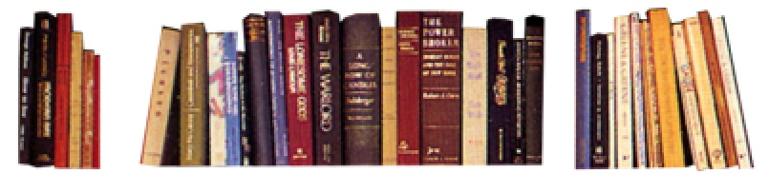
句型提炼
Sb. do sth. before …and sb. do sth, remembering that….
应用提示
用于表达“某人受到暗示或提示后采取的行动”。
句型应用
Notes:
13

Slide 14
典型例句
要不是我突然瞥见妈妈期待的神情，我几乎都要放弃该场比赛了。想起来还有几个比赛，我又一次站了起来。
意群提示
(expecting looks /compete in )
I almost gave up the game before my eyes caught my mom’s expecting looks she wore on the face and I stood up again, remembering that I still had more games to compete in.

Slide 15
原句译文
我们旅行是因为我们想要去旅行，因为到一个新地方的兴奋和激动可以抵消在机场的各种烦心事。
逆译练习
We travel because we want to, because the annoyances of the airport are offset by the thrill of being someplace new. (Para. 4)
句型提炼
Notes:
15

Slide 16
句型提炼
Sb. do sth. because sb.like/dislike to, because….
应用提示
用于表达“某人喜欢/不喜欢做某事的种种原因或理由”。
句型应用
Notes:
16

Slide 17
典型例句
我网购是因为我喜欢网购，因为网购可以免去我的腿脚之苦从而节省精力。
(online shopping / save feet)
I shop online because I like to, because online shopping can save my feet and energy.

Slide 18
原句译文
有研究指出，体验异国文化可以赋予我们宝贵的开放性思维，使我们更容易明白即使是微不足道的事物也可以有多种意义。
逆译练习
According to research, the experience of an exotic culture endows us with a valuable open-mindedness, making it easier to realize that even a trivial thing can have multiple meanings. (Para. 6)
句型提炼
Notes:
18

Slide 19
句型提炼
According to research, sth. / sb. do …, making it easier to do …
应用提示
用于引证，表达“研究发现/结果表明”。
句型应用
Notes:
19

Slide 20
典型例句
根据最近的调查，汽车拥有量已经在过去的五年时间里翻了一倍，致使交通事故不断攀升。
意群提示
(recent survey / doubled / climbing )
According to a recent survey, the number of car doubled over the past five years, leading to the climbing traffic accidents.

Slide 21



我们要想认识到旅
行在提高创新力方面的价值，还得再全面考虑其目的。
a. If we want to realize the creative benefits of travel, then we have to rethinks its overall purpose. (Para. 5, L4)

Slide 22
b. A bit of distance, however, helps loosen the cognitive chains that imprison us, making it easier to mingle the new with the old; the mundane is grasped from a lightly more abstract perspective. (Para. 6, L4)
然而，一点的距离就可以帮助我们放松禁锢我们认知的链条，使新旧思想的结合更容易，使平淡无奇的事情可从更抽象的角度加以认知。

Slide 23
c. Of course, this mental flexibility doesn’t come from mere distance, a simple change in latitude and longitude. Instead, this renaissance of creativity appears to be a side effect of difference. (Para. 8, L6)
当然，这种思维的灵活性不仅仅来自纯粹的距离变化，即简单的经纬度的变化。相反，这种创造力的复兴似乎是差异所带来的副产品。

Slide 24

d. We travel because we need to, because distance and difference are the secret cornerstones of creativity. (Para. 9, L4)
我们旅行是因为我们需要旅行，因为距离与差异是创造力的秘密基石。

Slide 25
我们回家后，家还是那个家，但是我们的思维已经有所改变，而这就可以改变一切。 。
e. When we get home, home is still the same. But something in our mind has been changed, and that changes everything. (Para. 9, L6)

